Slide 1
Group 4
Networking Part 2

Slide 2
Network Model
The network model is the extension of the hierarchical structure because it allows many-to-many relationships to be managed in a tree-like structure that allows multiple parents.

Slide 3
What Is The OSI Model?
The Open Systems Interconnection (OSI) model is a conceptual model created by the International Organization for Standardization which enables diverse communication systems to communicate using standard protocols.

Slide 4
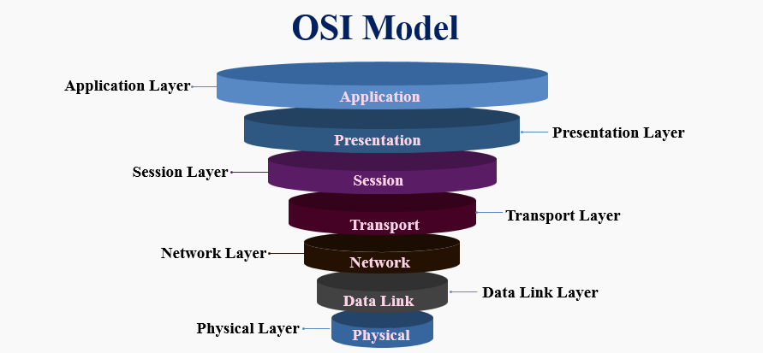
The 7 layers of OSI Model

Slide 5
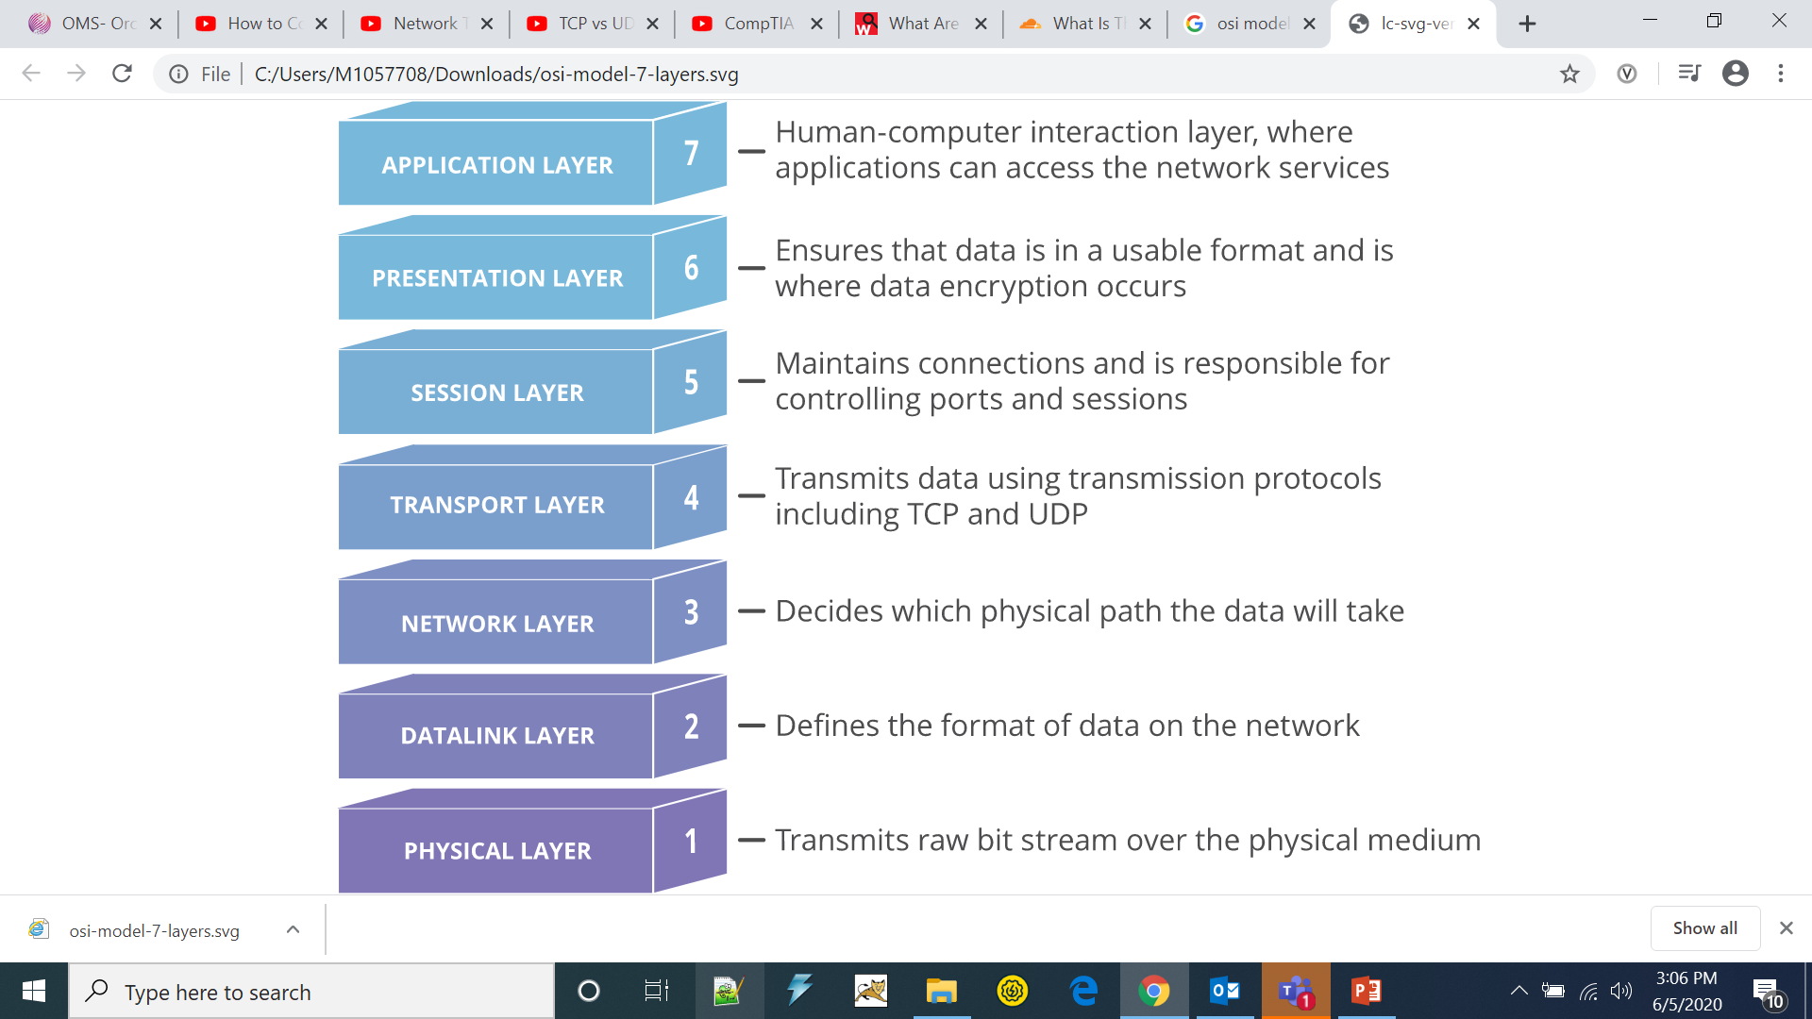
The 7 layers of OSI Model

Slide 6
The Physical Layer
This layer includes the physical equipment involved in the data transfer, such as the cables and switches. This is also the layer where the data gets converted into a bit stream, which is a string of 1s and 0s. The physical layer of both devices must also agree on a signal convention so that the 1s can be distinguished from the 0s on both devices.

Slide 7
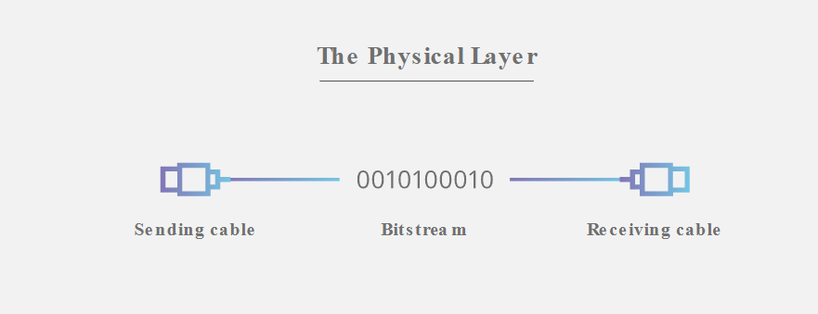

Slide 8
The Data Link Layer
The data link layer is very similar to the network layer, except the data link layer facilitates data transfer between two devices on the SAME network. The data link layer takes packets from the network layer and breaks them into smaller pieces called frames. Like the network layer, the data link layer is also responsible for flow control and error control in intra-network communication (The transport layer only does flow control and error control for inter-network communications).

Slide 9
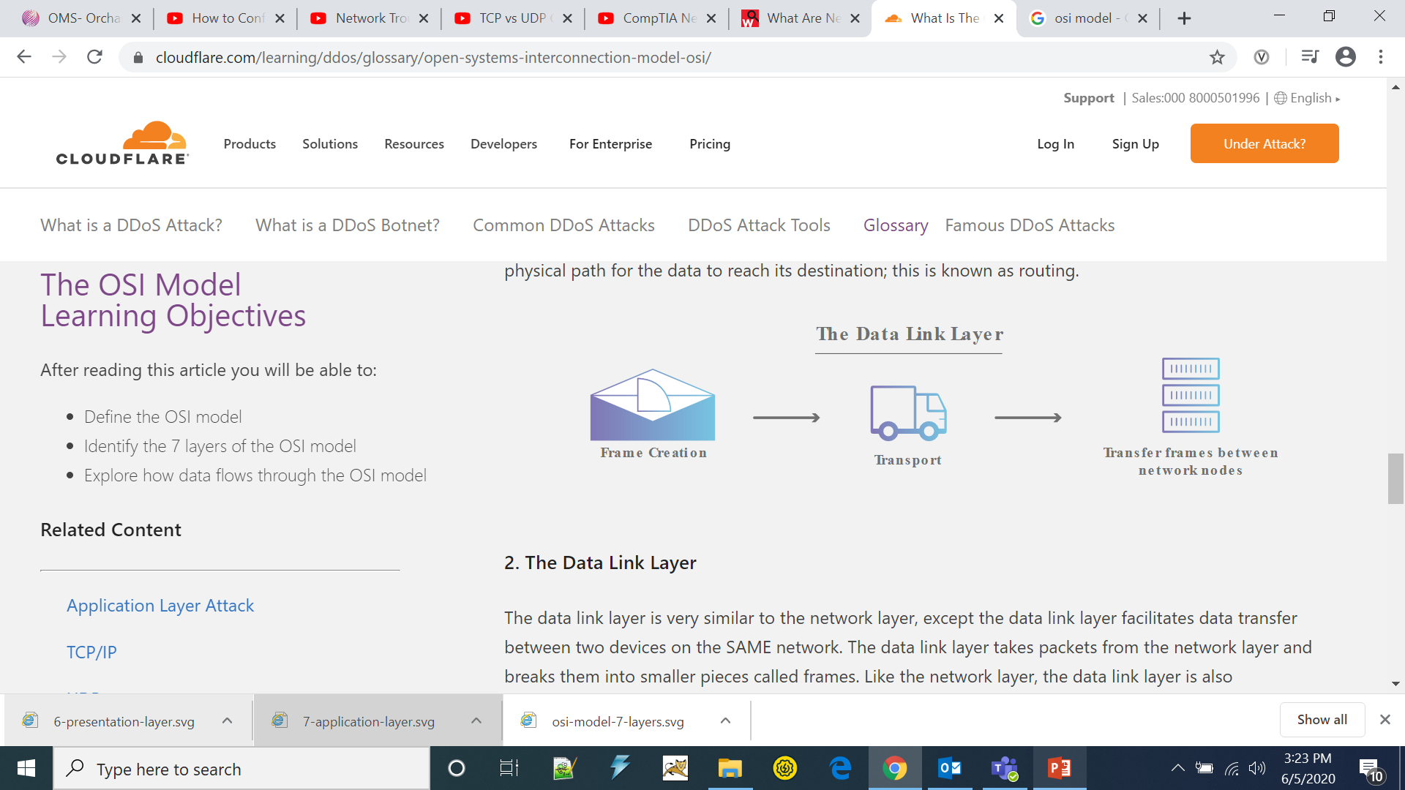

Slide 10
The Network Layer
The network layer is responsible for facilitating data transfer between two different networks. If the two devices communicating are on the same network, then the network layer is unnecessary. The network layer breaks up segments from the transport layer into smaller units, called packets, on the sender’s device, and reassembling these packets on the receiving device. The network layer also finds the best physical path for the data to reach its destination; this is known as routing.

Slide 11
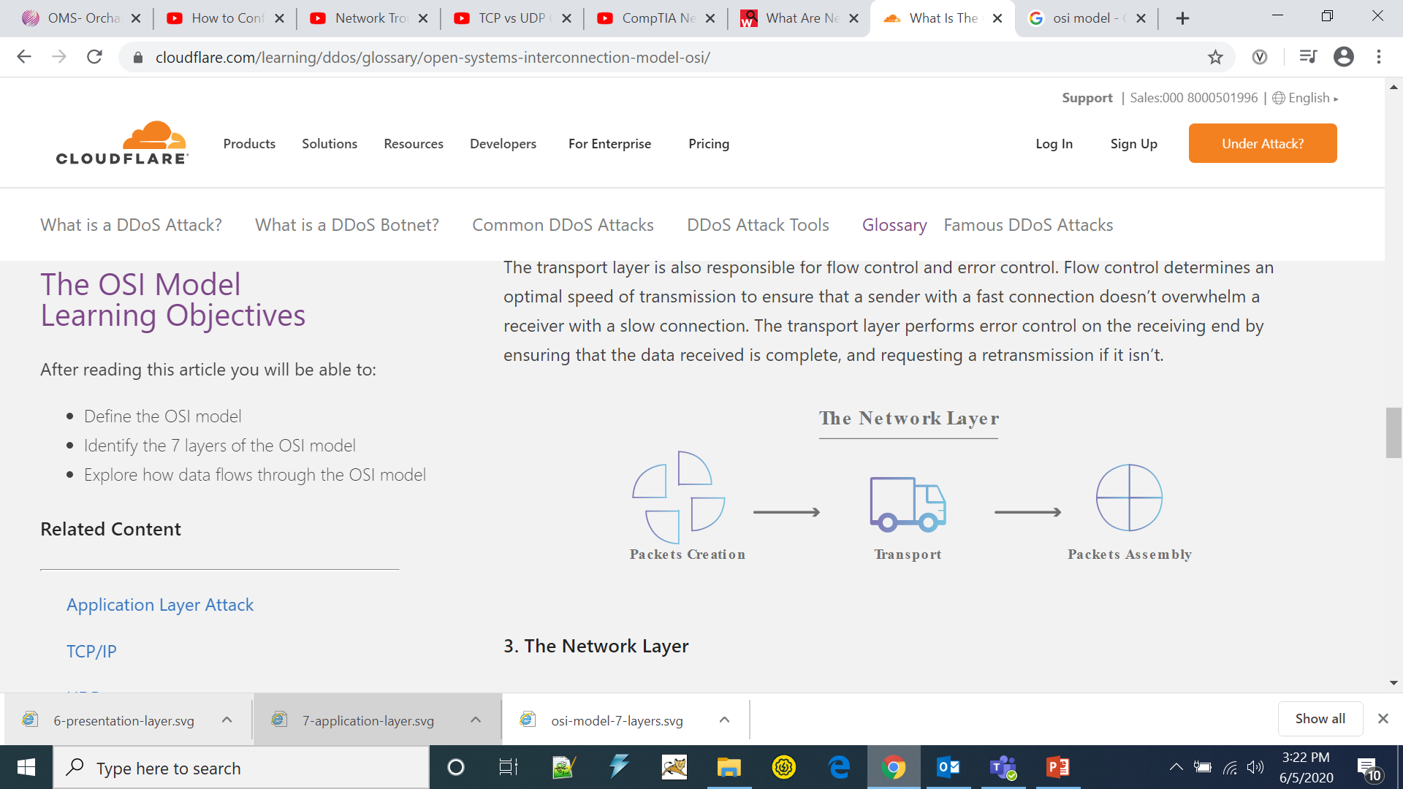

Slide 12
The Transport Layer
Layer 4 is responsible for end-to-end communication between the two devices. This includes taking data from the session layer and breaking it up into chunks called segments before sending it to layer 3. The transport layer on the receiving device is responsible for reassembling the segments into data the session layer can consume.
The transport layer is also responsible for flow control and error control. Flow control determines an optimal speed of transmission to ensure that a sender with a fast connection doesn’t overwhelm a receiver with a slow connection. The transport layer performs error control on the receiving end by ensuring that the data received is complete, and requesting a retransmission if it isn’t.

Slide 13
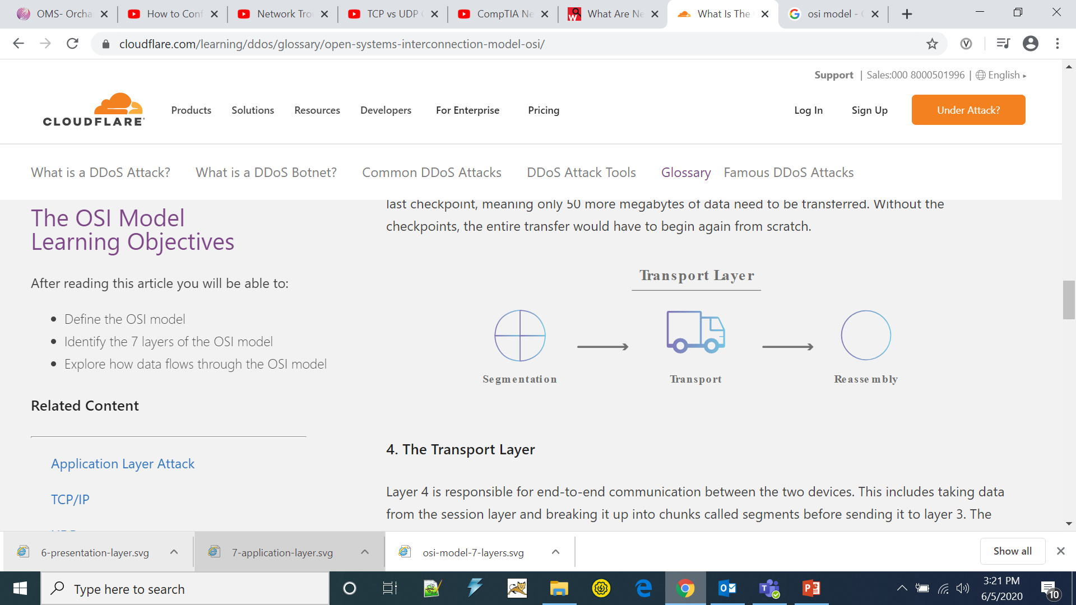

Slide 14
The Session Layer
This is the layer responsible for opening and closing communication between the two devices. The time between when the communication is opened and closed is known as the session. The session layer ensures that the session stays open long enough to transfer all the data being exchanged, and then promptly closes the session in order to avoid wasting resources.
The session layer also synchronizes data transfer with checkpoints.

Slide 15
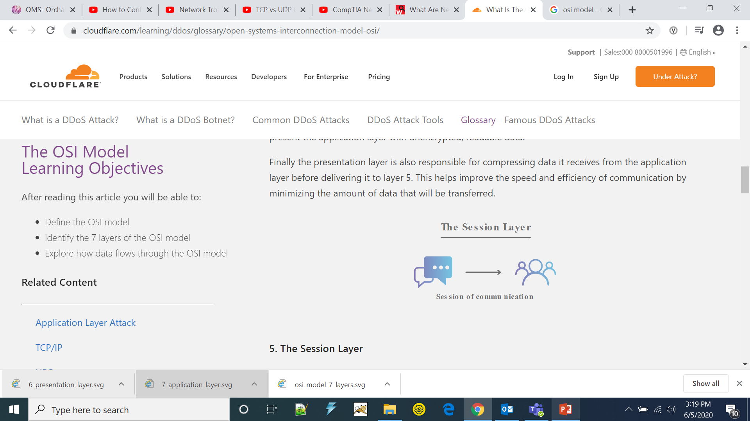

Slide 16
The Presentation Layer
This layer is primarily responsible for preparing data so that it can be used by the application layer; in other words, layer 6 makes the data presentable for applications to consume. The presentation layer is responsible for translation, encryption, and compression of data.
Two communicating devices communicating may be using different encoding methods, so layer 6 is responsible for translating incoming data into a syntax that the application layer of the receiving device can understand.

Slide 17
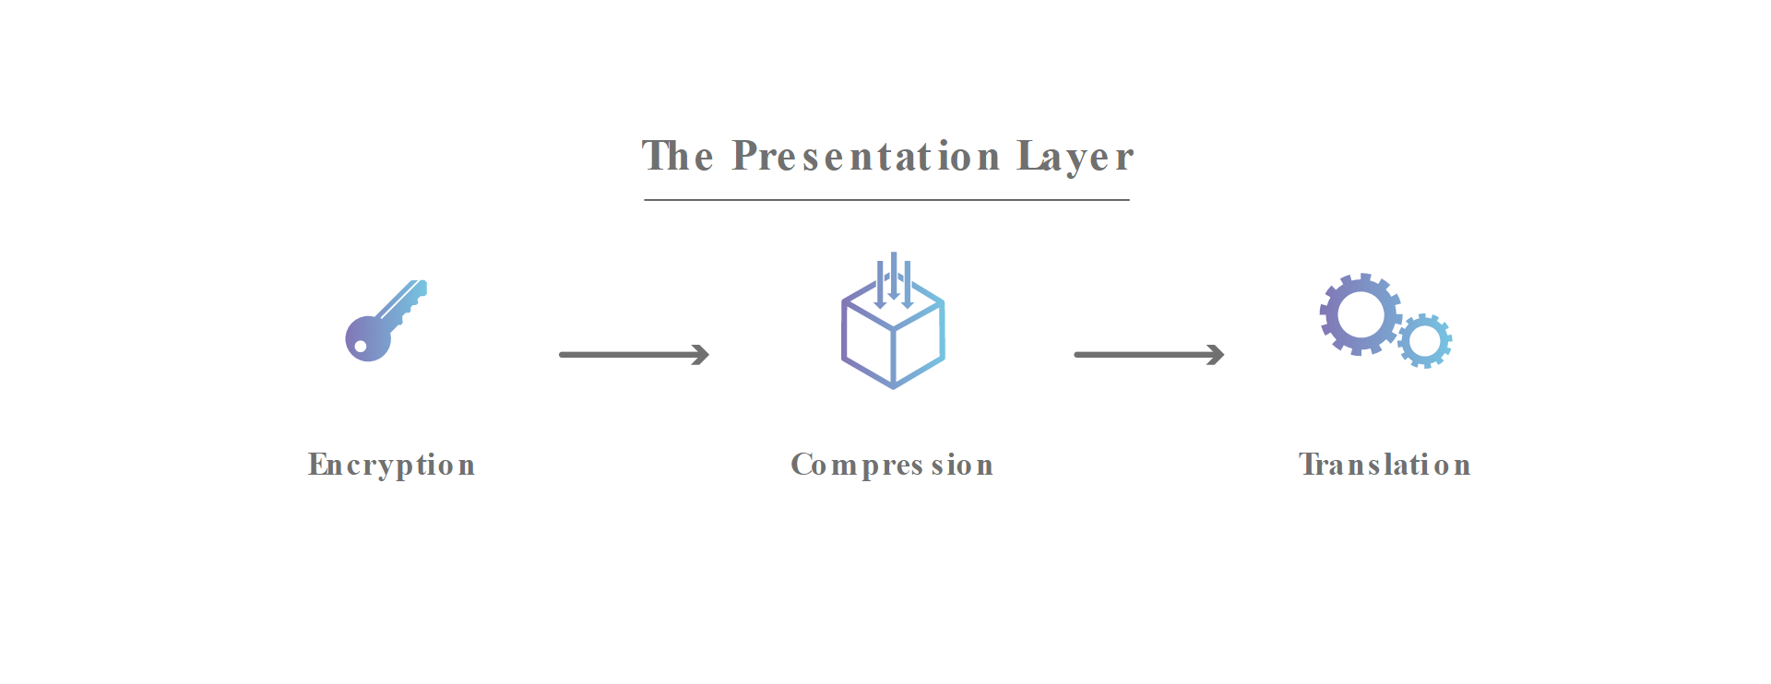

Slide 18
The Application Layer
This is the only layer that directly interacts with data from the user. Software applications like web browsers and email clients rely on the application layer to initiate communications. But it should be made clear that client software applications are not part of the application layer; rather the application layer is responsible for the protocols and data manipulation that the software relies on to present meaningful data to the user. Application layer protocols include HTTP as well as SMTP (Simple Mail Transfer Protocol is one of the protocols that enables email communications).

Slide 19
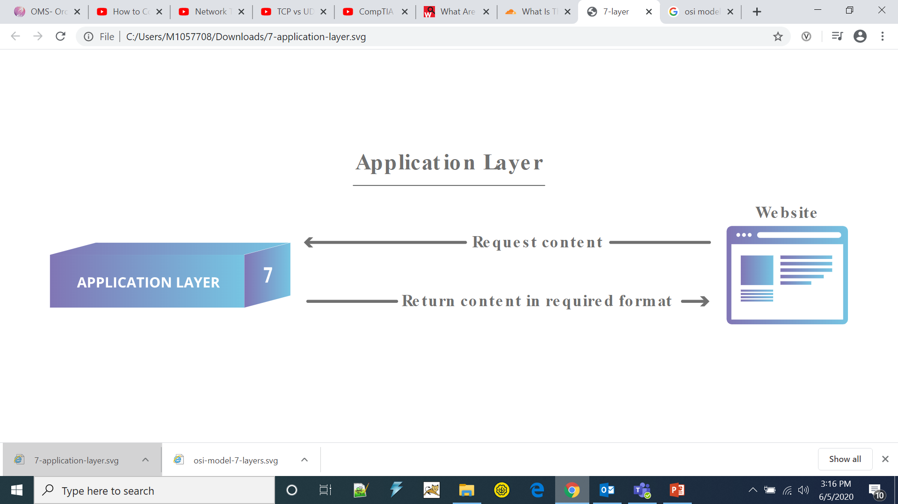

Slide 20
What is the TCP/IP Model?
TCP/IP Model helps you to determine how a specific computer should be connected to the internet and how data should be transmitted between them. It helps you to create a virtual network when multiple computer networks are connected together. The purpose of TCP/IP model is to allow communication over large distances.
TCP/IP stands for Transmission Control Protocol/ Internet Protocol. It is specifically designed as a model to offer highly reliable and end-to-end byte stream over an unreliable internetwork.

Slide 21
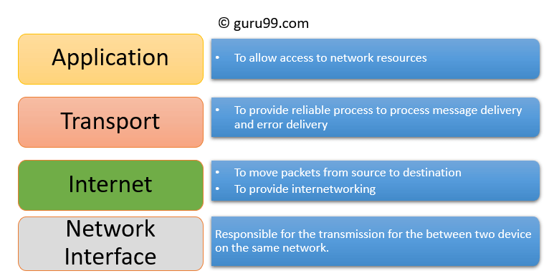
Four Layers of TCP/IP

Slide 22
Application Layer
Application layer interacts with an application program, which is the highest level of OSI model. The application layer is the OSI layer, which is closest to the end-user. It means the OSI application layer allows users to interact with other software application.

Slide 23
Transport Layer
Transport layer builds on the network layer in order to provide data transport from a process on a source system machine to a process on a destination system. It is hosted using single or multiple networks, and also maintains the quality of service functions.
It determines how much data should be sent where and at what rate. This layer builds on the message which are received from the application layer. It helps ensure that data units are delivered error-free and in sequence.

Slide 24
Internet Layer
An internet layer is a second layer of the TCP/IP model. It is also known as a network layer. The main work of this layer is to send the packets from any network, and any computer still they reach the destination irrespective of the route they take.
The Internet layer offers the functional and procedural method for transferring variable length data sequences from one node to another with the help of various networks.

Slide 25
Network Interface Layer
Network Interface Layer is this layer of the four-layer TCP/IP model. This layer is also called a network access layer. It helps you to defines details of how data should be sent using the network.
It also includes how bits should optically be signaled by hardware devices which directly interfaces with a network medium, like coaxial, optical, coaxial, fiber, or twisted-pair cables.

Slide 26
What is UDP?
User Datagram Protocol is a communication protocol used across the Internet for especially time-sensitive transmissions such as video playback or DNS lookups. It speeds up communications by not requiring what’s known as a “handshake”, allowing data to be transferred before the receiving party agrees to the communication. This allows the protocol to operate very quickly, and also creates an opening for exploitation.

Slide 27
What is Network Troubleshooting?
Network troubleshooting is the combined measures and processes used to identify, diagnose and solve problems within a computer network. It’s a logical process that network engineers use to resolve network problems and improve network operations. Troubleshooting is an iterative process, the more data you collect and analyze, the higher the likelihood of developing a correct hypothesis.

Slide 28
Network Troubleshooting commands
Ipconfig
The “ipconfig” displays the current information about your network such as your your IP and MAC address, and the IP address of your router. It can also display information about your DHCP and DNS servers.
ping
The “ping” command ping command allows you to send a signal to another device, and if that device is active, it will send a response back to the sender. The “ping” command is a subset of the ICMP (Internet Control Message Protocol), and it uses what is called an “echo request”. So, when you ping a device you send out an echo request, and if the device you pinged is active or online, you get an echo response.

Slide 29
Tracert
This command lets you see all steps a packet takes to the destination.
For example, if we send a packet to www.google.com, it actually goes through a couple of routers to reach the destination. The packet will first go to your router, and then it will go to all kinds of different routers before it reaches Google servers.

Slide 30
Nslookup
The nslookup command will fetch the DNS records for a given domain name or an IP address. Remember the IP addresses and domain names are stored in DNS servers, so the nslookup command lets you query the DNS records to gather information.

Slide 31
What’s a Proxy Server?
A proxy server acts as a gateway between you and the internet. It’s an intermediary server separating end users from the websites they browse. Proxy servers provide varying levels of functionality, security, and privacy depending on your use case, needs, or company policy.

Slide 32
Why Should You Use a Proxy Server?
To control internet usage of employees and children
Bandwidth savings and improved speeds
Privacy benefits
Improved security
Get access to blocked resources

